Slide 1
BSEN 5250/6250
Lecture 2
Analytical Models Based on
Differential Equations
Background Reading:
Chapter 1 of Computer Simulation in Biology by Keen and Spain

Slide 2
Introduction
Modeling biological processes requires understanding rates of change, how rates are influenced by environmental factors such as energy, temperature, pH, etc
Differential equations describe rates of change
There are several important classes of equations that describe biological processes

Slide 3
Modeling Process
Cause
(Stimulus)
System Component
Effect
(response)
Input
Output
Output
Input
X
Y = f(X)
Y
X
Y = A + B X
Y

Slide 4
Objectives of This Lecture
1. Derive several important differential equations describing biological processes
2. Compute solution of these equations
3. Evaluate the behavior of these equations

Slide 5
Model of Biological Growth
Biological System - growth rate in many biological processes is proportional to some property of the system. For instance, the growth rate of a cell may be proportional to the number of cells, or the growth of a plant may be proportional to the amount of biomass

Slide 6
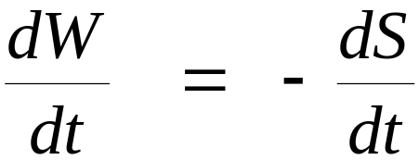
Model of Biological Growth
Substrate, S
Dry Weight, W
Two compartment model of growth
Assume no gain or loss of material from system
W + S = constant

Slide 7
Exponential Growth Model
Assumptions
Quantity of growth is proportional to dry weight W
Growth machinery works at maximum rate
Unlimited substrate to support growth
Substrate, S
Dry Weight, W

Slide 8
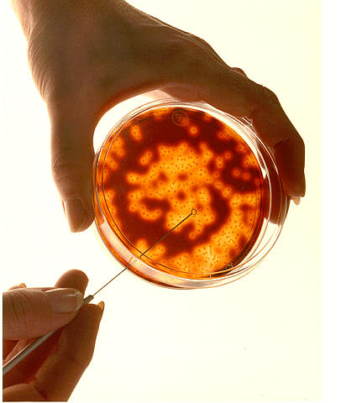
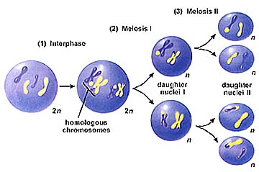
Exponential Growth Model
Example: Growth of Cell Population
Time

Slide 9
Exponential Growth Model
Cell Growth
G = f(N)
G = k*N
Where
G = growth rate, # cells/hr
N = number of cells
k = constant, 1/hr
G
K = slope
N

Slide 10
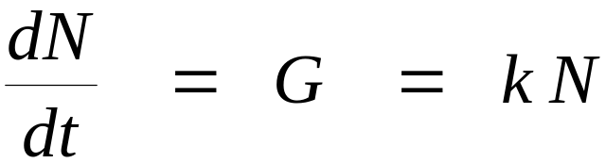
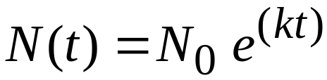
Exponential Growth Model
We are interested in modeling cell numbers
Governing Equation
Solution
N(t) = number of cells at time t
N₀ = initial number of cells
k = growth constant, 1/day
t = time, hrs

Slide 11
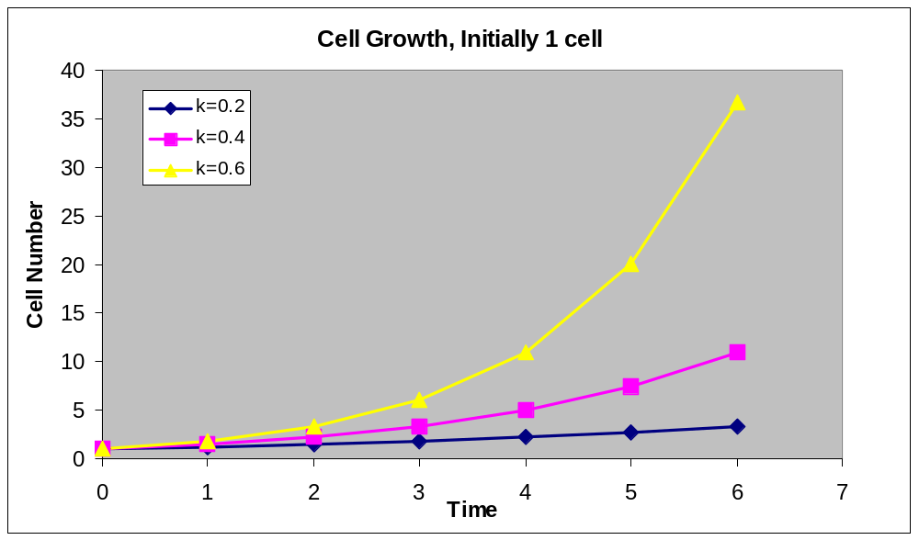
Exponential Growth Model
System Behavior

Slide 12
Exponential Growth Model with Cut-off
Substrate, S
Dry Weight, W
Assumptions
Quantity of growth is proportional to dry weight W
Growth machinery works at maximum rate until S is exhausted
Growth is irreversible and stops when S is exhausted

Slide 13
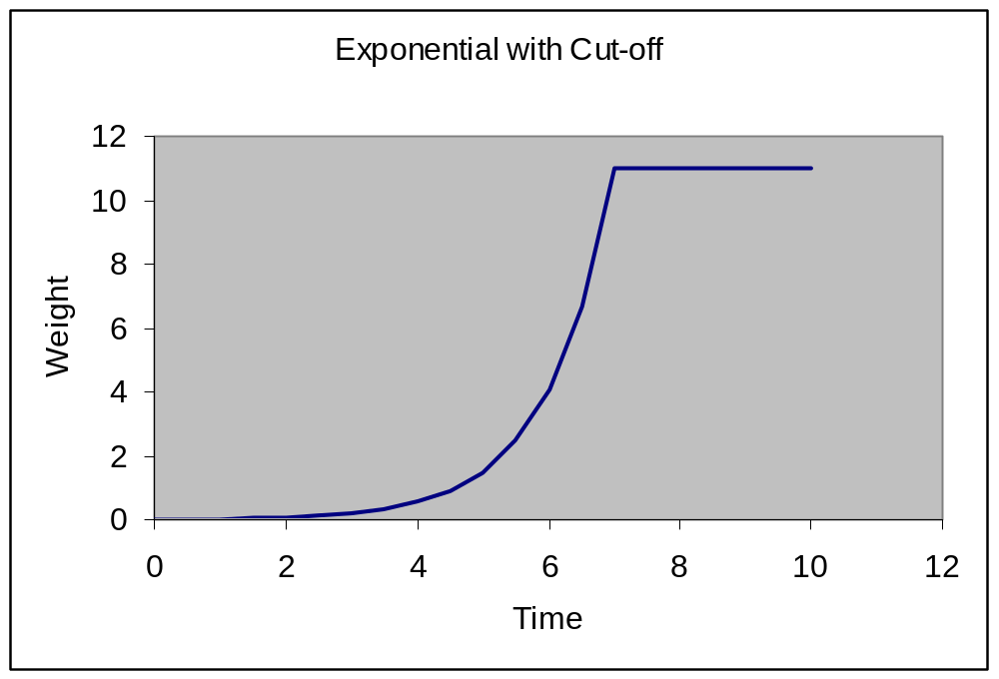
Exponential Growth Model with Cut-off

Slide 14
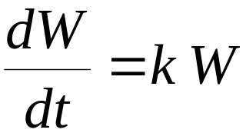
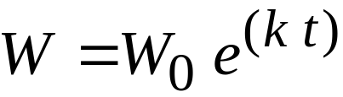
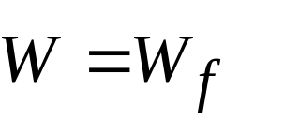
Exponential Growth Model with Cut-off
Governing Equation:
Solution:
0< t < t_{f}
T > t_{f}
W = weight, g
t = time, day
k = growth constant, 1/day
t_{f} = time substrate is exhausted, day
W₀ = initial weight at time t=0, g
W_{f} = final weight when substrate is exhausted

Slide 15
Monomolecular Growth Model
Substrate, S
Dry Weight, W
Assumptions
Quantity of growth is constant and independent of dry weight W
Growth machinery works at rate proportional to substrate S
Growth is irreversible

Slide 16
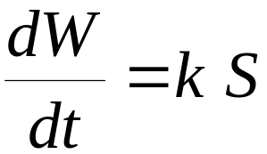
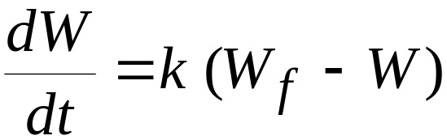
Monomolecular Growth Model
[Eq. 1]
Since S_{f} = 0, then S = (W_{f} – W)
Substituting into [1] gives
[Eq. 2]
Where S_{f} is final amount of substrate and W_{f} is final weight

Slide 17
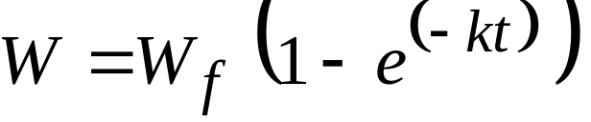
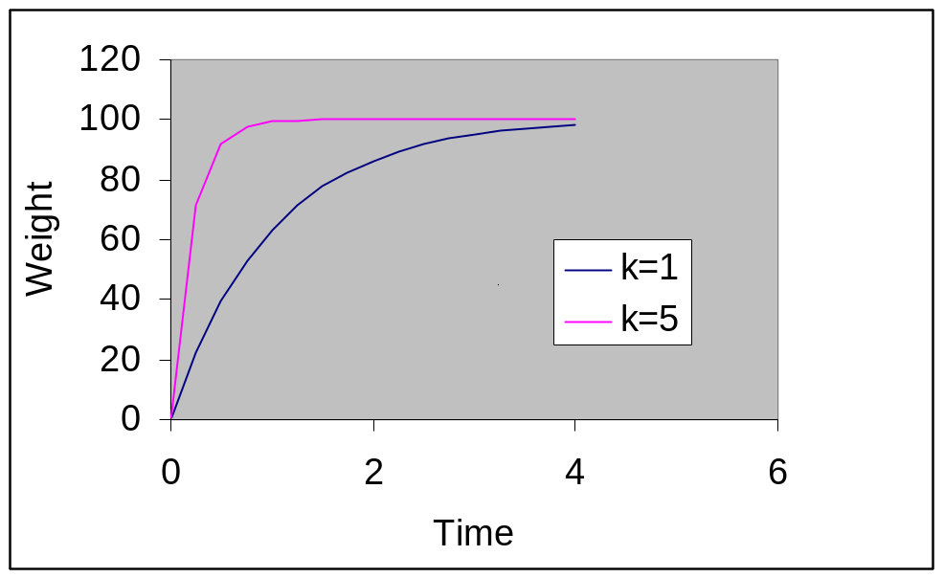
Monomolecular Growth Model
Integrating [Eq. 2] gives

Slide 18
Logistic Growth Model
Substrate, S
Dry Weight, W
Assumptions
Quantity of growth machinery is proportional to dry weight W
Growth machinery works at rate proportional to substrate S
Growth is irreversible

Slide 19
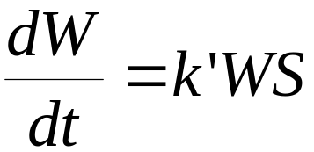
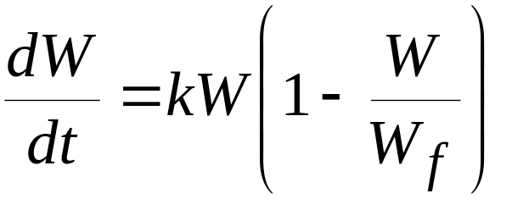
Logistic Growth Model
[Eq. 1]
Let S = W_{f} – W
Let k’ = k/W_{f}
Substitute this into Eq. 1 to get
[Eq. 2]

Slide 20
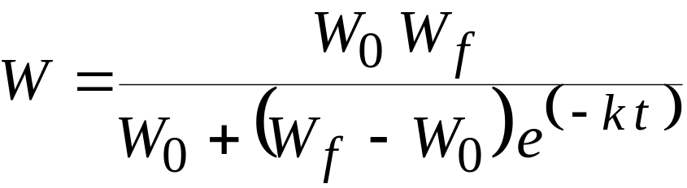
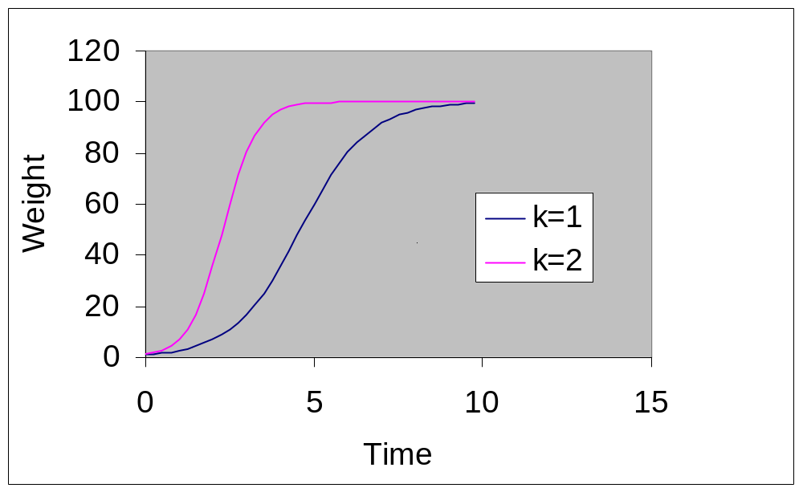
Logistic Growth Model
[Eq. 3]

Slide 21
Gompertz Growth Model
Substrate, S
Dry Weight, W
Assumptions
Growth machinery is always saturated with substrate S
Quantity of growth machinery is proportional to dry weight W
Effectiveness of growth machinery decays with time according to first order kinetics

Slide 22

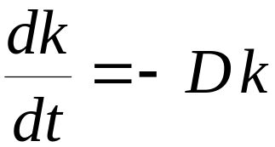
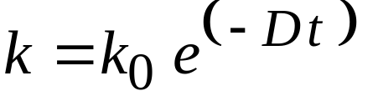
Gompertz Growth Model
Assumption 2 [Eq. 1]
Assumption 3 [Eq. 2]
Integrating Eq. 2 gives
[Eq. 3]

Slide 23
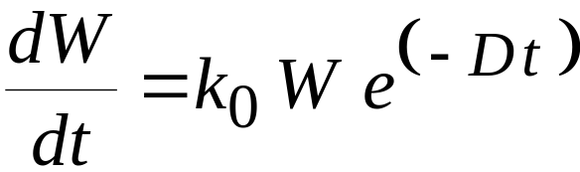
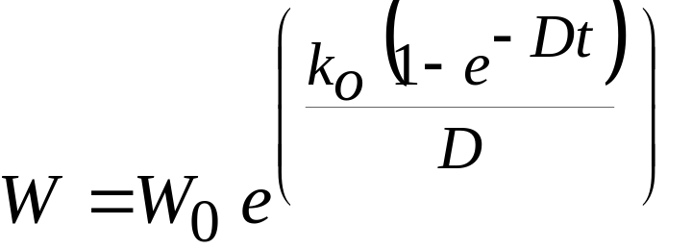
Gompertz Growth Model
Combining Equations 1 and 3 gives
[Eq. 4]
Integrating Equation 4 gives
[Eq. 5]

Slide 24
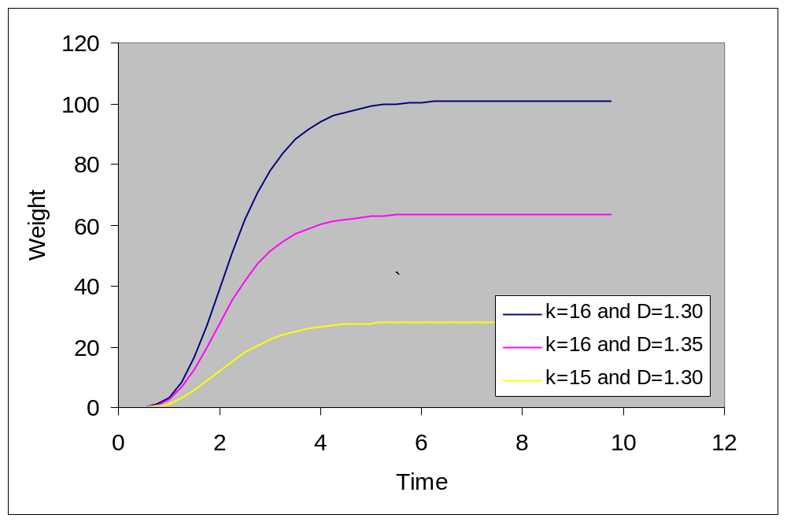
Gompertz Growth Model

Slide 25
Exponential Decay Processes
Decay is a common process in biological systems. Exponential decay describes the behavior of a process that decreases as a proportion to the amount of material, energy, chemical potential, etc that is present.
- Change in chemical composition
- Weight loss during starvation
- Light absorption by a liquid
- Excretion of drug into the bloodstream
- Distribution of populations

Slide 26
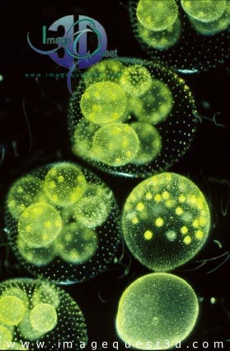
Exponential Decay Processes
Colonial Green Algae requires nitrogen to survive. If the algae is isolated in a tank with no influx of N, what is the relationship that describes the decay of nitrogen in the tank over time?

Slide 27
Exponential Decay Processes
Nitrogen uptake is proportional to the amount of N present in the solution
N uptake
dN/dt = f(C)
Where
N = rate of nitrogen molecules
uptake into the algae, mole/sec
C = amount of nitrogen in
solution, moles
T = time
Solution

Slide 28
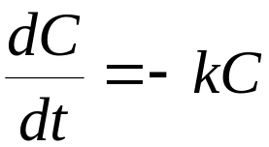
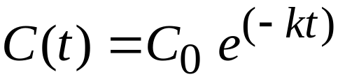
Exponential Decay Processes
Concentration (C) is often used to measure chemical levels in parts per million, or milligram per liter
C
k = slope
dC
dt
Where C = concentration, ppm
t = time, seconds
k = decay rate, 1/time
C₀ = initial concentration at time 0, ppm

Slide 29
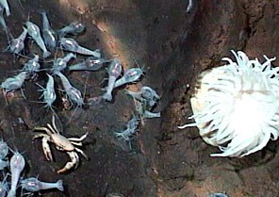
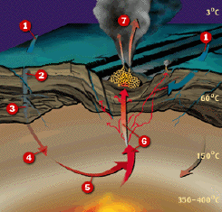
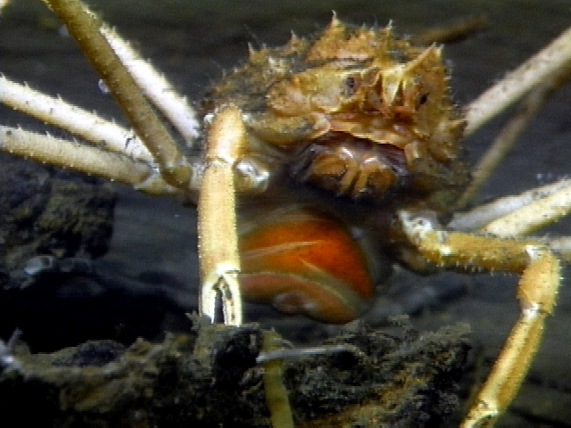
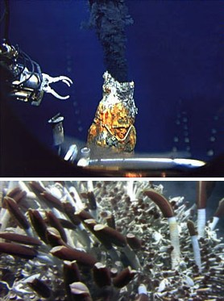
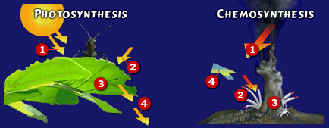
Distribution of Deep Water Crabs Around Hydrothermal Vent

Slide 30
Example 1-5: Crab Distribution Around Hydrothermal Vent
Given: Exponential decay describes the distribution of crabs around a hydrothermal vent on the ocean floor. Crab density is measured with a camera, and the number of crabs are counted per unit viewing area of the camera (about 845 m²).
Population at vent: 100/unit camera area
Decay Rate: 8.56/km
Find: Compute population distribution of crabs within 600m of the vent

Slide 31
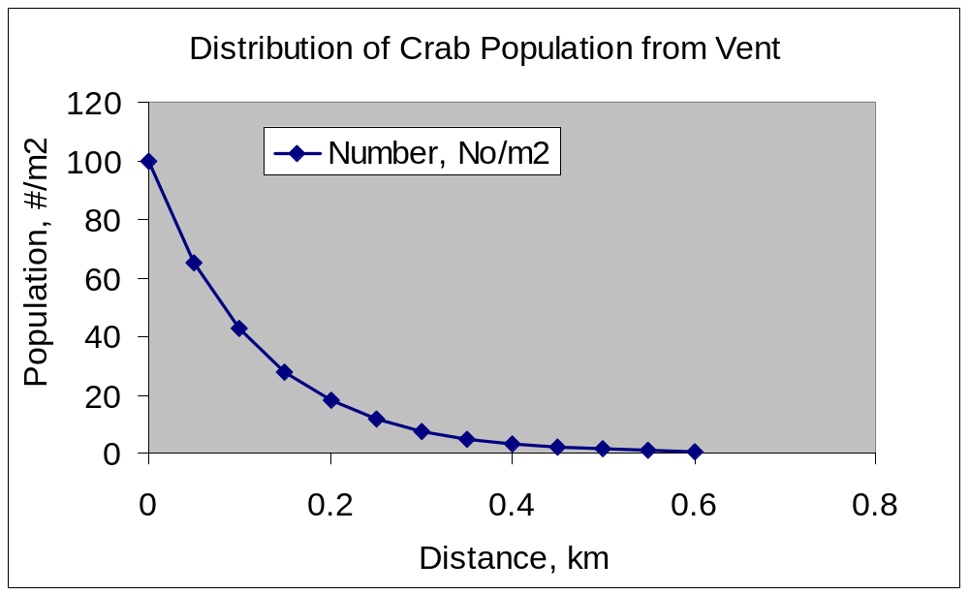


Example 1-5: Crab Distribution Around Hydrothermal Vent
Solution:
X is distance from vent, km
At 0.6 km, the population is 0.588 crabs/m²

Slide 32
Exponential Decay to Asymptote
Substrate, S
Substance, W
reversed
Assumptions
Quantity of decay is proportional to substance W above an equilibrium state
Decay machinery works at maximum rate
Process is irreversible

Slide 33
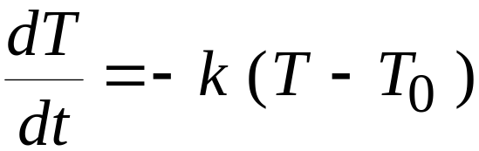
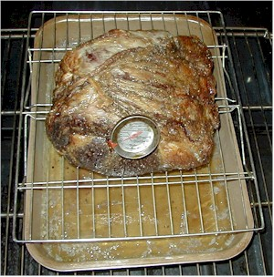
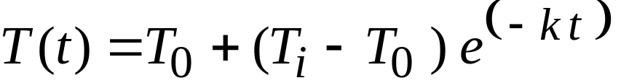
Exponential Decay to Asymptote
Example: Newton’s Law of Cooling
T(t) = temperature at time t, C
T₀ = environmental temperature, C
T_{i} = temp. of body at time t=0, C
K = decay constant, 1/min
T = time, min

Slide 34
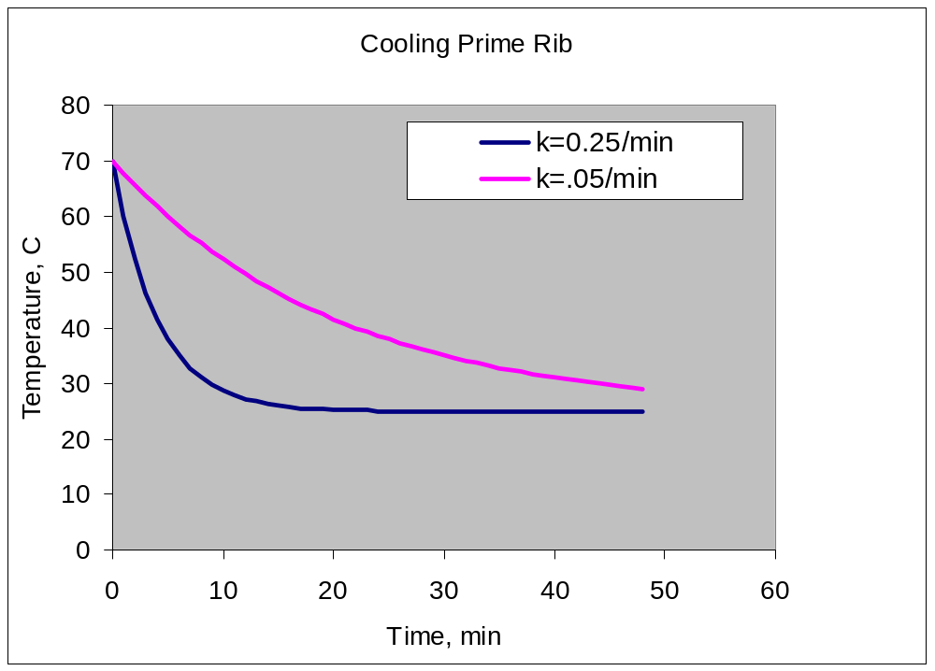
Exponential Decay to Asymptote

Slide 35
Summary
Exponential Growth
Exponential Growth with Cut-off
Monomolecular Growth
Logistic Growth
Gompertz Growth
Exponential Decay
Exponential Decay to Asymptote

